Slide 1
MAC Registers
By vennapusa sravanthi
Chipweave technologies pvt ltd

Slide 2
Mac registers are used to configure, control, and monitor the MAC layer of a communication interface.
These registers are grouped into 4 logical blocks.
1)Rx Margin Status – Signal quality / eye margin
2)Elastic Buffer – Clock compensation (SerDes-related)
3)Rx Status / Control – Link, error, and control info
4)Link Evaluation Status – Link quality monitoring

Slide 3
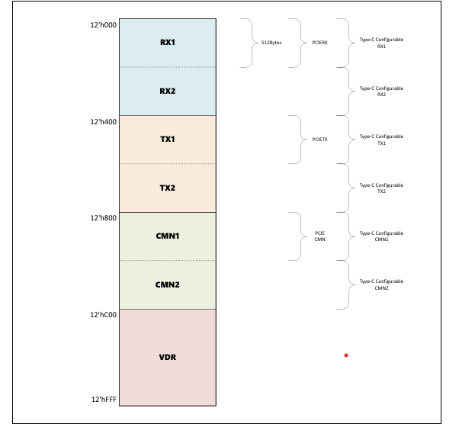
Message bus address space

Slide 4
Byte Address | Register name
12’h0 | RX1: Rx Margin Status0
12’h1 | RX1: Rx Margin Status1
12’h2 | RX1: Rx Margin Status2
12’h3 | RX1: Elastic Buffer Status
12’h4 | RX1: Elastic Buffer Location
12’h5 | RX1: Rx Status0
12’h6 | RX1: Rx Control0
12’h7 | RX1: Rx Margin Status3
12’h8 – 12’h9 | RX1: Reserved
12’hA | RX1: Rx Link Evaluation Status0
12’hB | RX1: Rx Link Evaluation Status1
12’hC | RX1: Rx Status4
12’hD | RX1: Rx Status5
12’hE | RX1: Rx Link Evaluation Status2
12’hF | RX1: Rx Link Evaluation Status3

Slide 5
Byte address | Register Name
12’h400 | TX1: Tx Status0
12’h401 | TX1: Tx Status1
12’h402 | TX1: Tx Status2
12’h403 | TX1: Tx Status3
12’h404 | TX1: Tx Status4
12’h405 | TX1: Tx Status5
12’h406 | TX1: Tx Status6
12’h407 | TX1: Tx Status7
12’h408 | TX1: Tx Status8
12’h409 | TX1: Tx Status9
12’h40A | TX1: Tx Status10
12’h40B | TX1: Tx Status11

Slide 6
Address | Rx margin status | Bit | Default | Attribute | Required | Description
0h | 0 | [7:2] | 0h | N/A | N/A | Reserved
0h | 0 | 1 | 0h | 1 cycle | PCIe | This field indicates that the PHY has received a voltage margin request with an unsupported offset within the advertised range
0h | 0 | 0 | 0h | 1 cycle | PCIe | This field is used by the PHY to acknowledge a valid change to the “Start Margin” field or the “Margin Offset[6:0]” field

Slide 7
Address 1h: Rx Margin Status1
Bit | Default | Atribute | Required | Description
7 | 0h | N/A | N/A | Reserved
[6:0] | 0h | level | PCIe | Sample Count: This field indicates the number of bits that have been margined and can increment only when “Start Margin” is asserted. The value of this field is 3×log2(number of bits margined). This field stops incrementing when the “Error Count” saturates.

Slide 8
Address 2h: Rx Margin Status2
Bit | Default | Attribute | Required | Description
[7:0] | 0h | level | PCIe | This field is used by the PHY to report actual bit errors to the MAC. For PCIe, the upper two bits are reserved and only the lower 6 bits are utilized.

Slide 9
Address 3h: Elastic Buffer Status
Bit | Default | Attribute | Required | Description
[7:1] | 0h | N/A | N/A | reserved
0 | 0h | 1 cycle | PCIe | Elastic Buffer Status: The PHY sets this status bit to 1’b1 when it has completed its elastic buffer depth adjustment to the value specified in the Elastic Buffer Control register. This field is not used in the SerDes architecture

Slide 10
Address 4h: Elastic Buffer Location
Bit | Default | Attribute | Required | Description
[7:0] | 0h | level | PCIe | ElasticBufferLocation: This field reflects the number of entries that are currently in the elastic buffer

Slide 11
Address 5h: Rx Status0
Bit | Default | Attribute | Required | Description
[7:2] | 0h | N/A | N/A | reserved
1 | 0h | 1 cycle | PCIe | IORecalDone: This field is set to “1” to indicate that an IORecal operation has successfully completed
0 | oh | 1 cycle | PCIe | RxEqTrainDone: This field is set to 1’b1 to indicate that receiver training is complete in response to an RxEqTraining request

Slide 12
Address 6h: Rx Control0
Bit | Default | Attribute | Required | Description
[7:1] | 0h | N/A | N/A | reserved
0 | 0h | 1 cycle | PCIe | PhyIORecalRequest: The PHY sets this to “1” to indicate that the controller should enter Recovery and request of an Rx recalibration via the IORecal bit

Slide 13
Address 7h: Rx Margin Status3 is used by the USB
Address 8h and 9h are reserved

Slide 14
Address Ah: Rx Link Evaluation Status0
Bit | Default | Attribute | Required | Description
[7:0] | 0h | level | PCIe | LinkEvaluationFeedbackFigureMerit[7:0]: This field provides the PHY link equalization evaluation Figure of Merit Value. The value is encoded as an unsigned integer from 0 to 255. An encoding of 0 is the worst, and an encoding of 255 is the best

Slide 15
Address Bh: Rx Link Evaluation Status1
Bit | Default | Attribute | Required | Description
[7:6] | 0h | N/A | N/A | reserved
[5:0] | 0h | level | PCIe | LinkEvaluationFeedbackDirectionChange[5:0]: This field provides the link equalization evaluation feedback in the direction change format. Feedback is provided for each coefficient: [1:0] C-1 [3:2] C0 [5:4] C1 The feedback value for each coefficient is encoded as follows: 00 - No change 01 – Increment 10 – Decrement 11 - Reserve

Slide 16
Address Ch: Rx Status4
Bit | Default | Attribute | Required | Description
[7:6] | 0h | N/A | N/A | reserved
[5:0] | 0h | level | PCIe | LocalG5FS[5:0] This field reflects the FS value for the PHY. These signals are only used by a PHY that requires dynamic preset coefficient updates. The FS value is valid for 32 GT/s.

Slide 17
Address Dh: Rx Status5
Bit | Default | Attribute | Required | Description
[7:6] | 0h | N/A | N/A | reserved
[5:0] | 0h | level | PCIe | LocalG5LF[5:0] This field reflects the LF value for the PHY. This signal is only used by a PHY that requires dynamic preset coefficient updates. The LF value is valid for 32 GT/s

Slide 18
Address Eh: Rx Link Evaluation Status2
Bit | Default | Attribute | required | Description
7 | 0h | N/A | N/A | Reserved
[6:4] | 0h | level | PCIe | LinkEvalFeedbackDirectionChange_Cminus1[2:0]: This field provides link equalization evaluation feedback in the direction change format for coefficient C-1 when operating at a rate of 64 GT/s and 128 GT/
3 | 0h | N/A | N/A | Reserved
[2:0] | 0h | Level | PCIe | 000 -- No change 001 -- Increment by 1 010 -- Decrement by 1 011 -- Increment by 2 100 -- Decrement by 2 101 -- Increment by 4 110 -- Decrement by 4 111 -- Reserved

Slide 19
Address Fh: Rx Link Evaluation Status3
Bit | Default | Attribute | Required | Description
7 | 0h | N/A | N/A | reserved
[6:4] | 0h | level | PCIe | This field provides link equalization evaluation feedback in the direction change format for coefficient C+1 when operating at a rate of 64 GT/s and 128 GT/s
3 | 0h | N/A | N/A | reserved
[2:0] | 0h | level | PCIe | This field provides link equalization evaluation feedback in the direction change format for coefficient C0 when operating at a rate of 64 GT/s and 128 GT/s

Slide 20
Address 10h: Rx Status 6
Bit | Default | Attribute | Required | Description
[7:1] | 0h | N/A | N/A | reserved
0 | 0h | level | USB,Display Port | RxLaneReady: This field is set to “1” by the PHY to indicate that the receiver is enabled

Slide 21
Address 400h: Tx Status0
Bit | Default | Attribute | Required | Description
[7:6] | 0h | N/A | N/A | reserved
[5:0] | 0h | level | PCIe | *This field provides TX preset equalization coefficients requested by the MAC from the PHY using GetLocalPresetCoefficients. *For 8/16/32 GT/s (non-64G PCIe), it is part of LocalTxPresetCoefficients[17:0]. *Coefficient mapping: [5:0] = C-1, [11:6] = C0, [17:12] = C+1. *The MAC drives these values on the TxDeemph bus when applying the selected preset. *The field is updated only if the PHY supports dynamic preset coefficient updates. *For PCIe 64 GT/s and above, this field represents C-1 only, with other coefficients (C-2, C0, C+1) provided separately.

Slide 22
Address 401h: Tx Status1
Bit | Default | Attribute | Required | Description
[7:6] | 0h | N/A | N/A | reserved
[5:0] | 0h | level | PCIe | For 8/16/32 GT/s, this field is LocalTxPresetCoefficients[11:6], representing the C0 (main cursor) coefficient within LocalTxPresetCoefficients[17:0]. For PCIe 64 GT/s and higher, it becomes LocalTxPresetCoefficients_Czero[5:0], one of four preset coefficients (C-2, C-1, C0, C+1). The MAC drives this value on TxDeemph_Czero when applying the preset, and it is updated only by PHYs supporting dynamic preset updates.

Slide 23
Address 402h: Tx Status2
Bit | Default | Attribute | Required | Description
[7:6] | 0h | N/A | N/A | reserved
[5:0] | 0h | level | PCIe | For 8/16/32 GT/s, this field is LocalTxPresetCoefficients[17:12], representing the C+1 (post-cursor) coefficient within LocalTxPresetCoefficients[17:0]. For PCIe 64 GT/s and higher, it is LocalTxPresetCoefficients_Cplus1[5:0], one of four coefficients (C-2, C-1, C0, C+1) returned after a GetLocalPresetCoefficients request. The MAC drives this value on TxDeemph_Cplus1 when applying the preset, and it is updated only by PHYs that support dynamic preset coefficient updates.

Slide 24
Address 403h: Tx Status3
Bit | Default | Attribute | Required | Description
[7:6] | 0h | N/A | N/A | reserved
[5:0] | 0h | level | PCie | LocalFS[5:0]: This field reflects the FS value for the PHY. These signals are only used by a PHY that requires dynamic preset coefficient updates. The FS value is valid for 8 GT/s.

Slide 25
Address 404h: Tx Status4
Bit | Default | Attribute | Required | Description
[7:6] | 0h | N/A | N/A | reserved
[5:0] | 0h | level | PCIe | LocalLF[5:0]: This field reflects the LF value for the PHY. This signal is only used by a PHY that requires dynamic preset coefficient updates. The LF value is valid for 8 GT/s.

Slide 26
Address 405h: Tx Status5
Bit | Default | Attribute | Required | Description
[7:6] | 0h | N/A | N/A | reserved
[5:0] | 0h | level | PCIe | LocalG4FS[5:0]: This field reflects the FS value for the PHY. These signals are only used by a PHY that requires dynamic preset coefficient updates. The FS value is valid for 16 GT/s.

Slide 27
Address 406h: Tx Status6
Bit | Default | Attribute | Required | Description
[7:6] | 0h | N/A | N/A | reserved
[5:0] | 0h | level | PCIe | LocalG4LF[5:0]: This field reflects the LF value for the PHY. This signal is only used by a PHY that requires dynamic preset coefficient updates. The LF value is valid for 16 GT/s.

Slide 28
Address 407h: Tx Status7
Bit | Default | Attribute | Required | Description
[7:6] | 0h | N/A | N/A | reserved
[5:0] | 0h | level | PCIe | LocalTxPresetCoefficients_Cminus2[5:0]: This field is part of a set of four coefficients for the preset on the LocalPresetIndex[5:0] after a GetLocalPresetCoefficients request for 64 GT/s or 128 GT/s This field is only updated by a PHY that requires dynamic preset coefficient updates

Slide 29
Address 408h: Tx Status8
Bit | Default | Attribute | Required | Description
[7:6] | 0h | N/A | N/A | reserved
[5:0] | 0h | level | PCIe | LocalG6FS[5:0]: This field reflects the FS value for the PHY. These signals are only used by a PHY that requires dynamic preset coefficient updates. The FS value is valid for 64 GT/s.

Slide 30
Address 409h: Tx Status9
Bit | Default | Attribute | Required | Description
[7:6] | 0h | N/A | N/A | reserved
[5:0] | 0h | level | PCIe | LocalG6LF[5:0]: This field reflects the LF value for the PHY. This signal is only used by a PHY that requires dynamic preset coefficient updates. The LF value is valid for 64 GT/s.

Slide 31
Address 40Ah: Tx Status10
Bit | Default | Attribute | Reserved | Description
[7:6] | 0h | N/A | N/A | reserved
[5:0] | 0h | level | USB and Display Port | TxLaneReady: This field is set to “1” by the PHY to indicate that the transmitter is enabled.

Slide 32
Address 40Bh: TxStatus11
Bit | Default | Attribute | Required | Description
[7:6] | 0h | N/A | N/A | reserved
[5:0] | 0h | level | PCIe | LocalG7FS[5:0]: This field reflects the FS value for the PHY. These signals are only used by a PHY that requires dynamic preset coefficient updates. The FS value is valid for 128 GT/s

Slide 33
Address 40Ch: TxStatus12
Bit | Default | Attribute | Required | Description
[7:6] | 0h | N/A | N/A | reserved
[5:0] | 0h | level | PCIe | LocalG7LF[5:0]: This field reflects the LF value for the PHY. These signals are only used by a PHY that requires dynamic preset coefficient updates. The LF value is valid for 128 GT/s.

Slide 34
Address 800h: Near End Loopback Status
Bit | Default | Attribute | Required | Description
[7:2] | 0h | N/A | N/A | reserved
1 | 0h | level | PCIe,USB and SATA | NELB Error: This field is set to “1” to indicate an error if the requested operation through the NELB Control register. Specifically, the following two scenarios may result in an error status: 1) TheNELB position is not supported or 2) The NELB enable bit is cleared when the PHY does not support exit from NELB via message bus and requires a PIPE reset instead.
0 | 0h | level | PCIe,USB and SATA | NELB State: This field indicates whether the PHY is in NELB mode: 0 – Normal Operation 1 – NELB Mode

Slide 35
Sample Operational Sequences
Active PM L0 to L0s and Back to L0 – PCIe Mode
PIPE PHY can be controlled to perform Active State Power Management on a link for the sequence of the link being in L0 state, transitioning to L0s state, and then transitioning back to L0 state.
When the MAC and higher levels have determined that the link should transition to L0s, the MAC transmits an electrical idle ordered set and then has the PHY transmitter go idle and enter P0s.

Slide 36
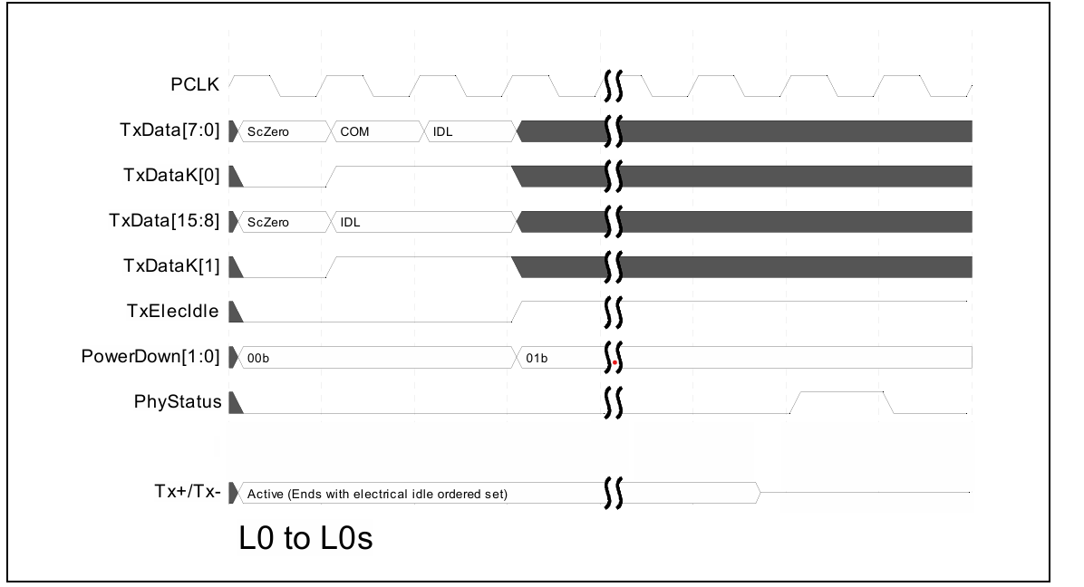
L0 to L0s

Slide 37
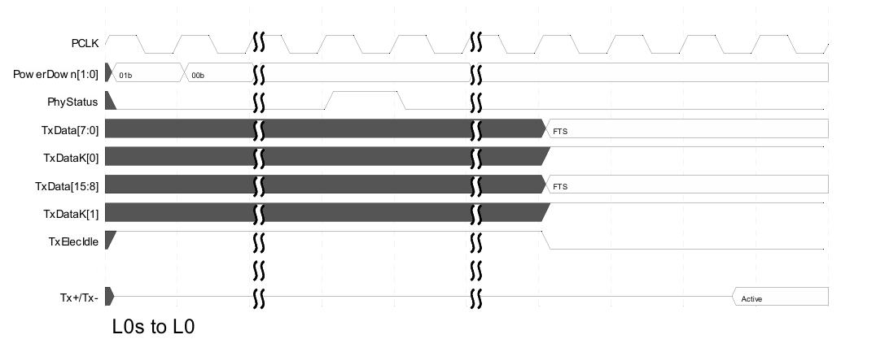
L0s to L0

Slide 38
Active PM to L1 and Back to L0 – PCIe Mode
PIPE PHY can be controlled to perform Active State Power Management on a link for the sequence of the link being in L0 state, transitioning to L1 state, and then transitioning back to L0 state.
This example assumes that the PHY is on an endpoint (that is, it is facing upstream) and that the endpoint has met all the requirements for entering L1.
After the MAC had the PHY send PM_Active_State_Request_L1 messages, and has received the PM_Request_ACK message from the upstream port, it then transmits an electrical idle ordered set, and has the PHY transmitter go idle and enter P1.

Slide 39
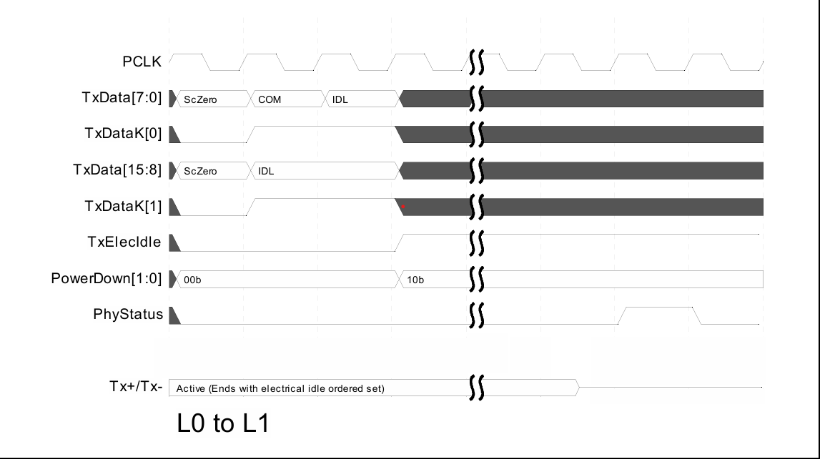
L0 to L1

Slide 40
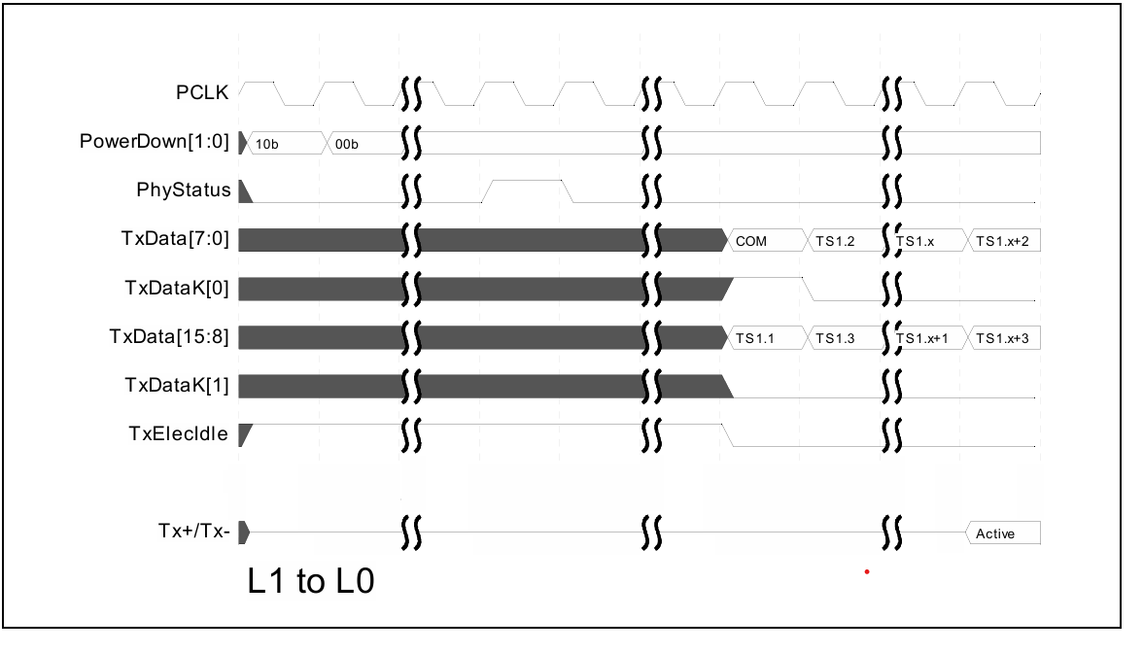
L1 To L0

Slide 41
Receivers and Electrical Idle – PCIe Mode
PHY operating to 2.5 GT/s, when operating at 5.0 GT/s or 8 GT/s signaling rates, RxElecIdle may not be reliable.
MACs should see the PCIe Revision 3.0 base specification or USB 3.0 specification for methods of detecting entry into the electrical idle condition.
The transmitter that is going to electrical idle may transmit garbage data and this data will show up on the RxData[] lines.
The MAC should discard any symbols received after the electrical idle ordered set until RxValid is deasserted

Slide 42
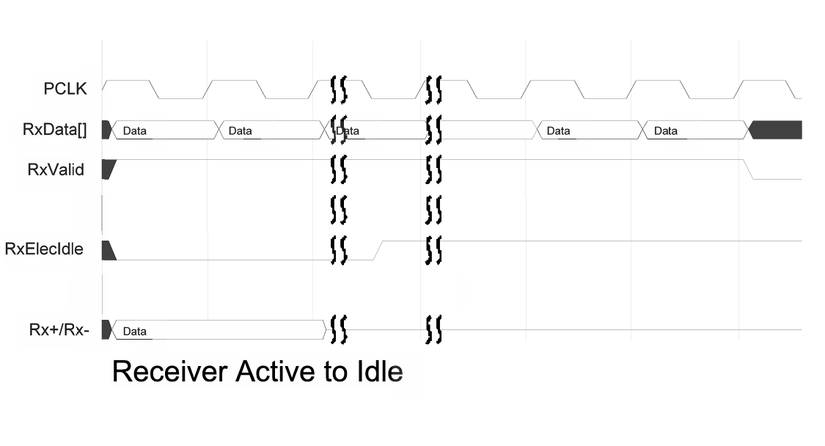
Receiver Active to Idle

Slide 43
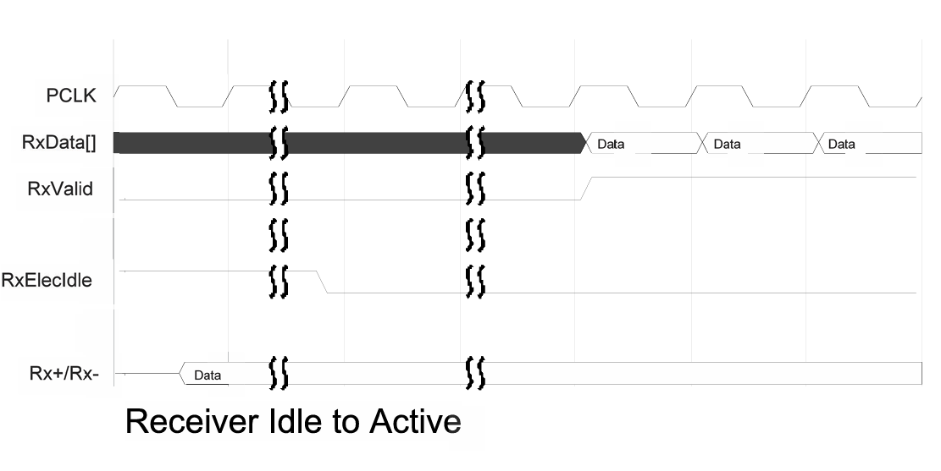
Receiver Idle to Active

Slide 44
CLKREQ#
CLKREQ# is used in some implementations by the downstream device to cause the upstream device to stop signaling on REFCLK.
When REFCLK is stopped, this will typically cause the CLK input to the PIPE PHY to stop as well.
For implementations that use CLKREQ# to further manage power consumption, PIPE compliant PHYs can be used as follows:
The general usage model is that to stop REFCLK,
the MAC puts the PHY into the P2 power state,
then deasserts CLKREQ#. To get the REFCLK

Slide 45
CLKREQ# in L1
If the MAC is moving the link to the L1 state and intends to deassert CLKREQ# to stop REFCLK, then the MAC follows the proper sequence to get the link to L1, but instead of finishing by transitioning the PHY to P1, the MAC transition the PHY to P2.
Then the MAC de asserts CLKREQ#. When the MAC wants to get the link alive again, it can:
• Assert CLKREQ#
• Wait for REFCLK to be stable (implementation specific)
• Wait for the PHY to be ready (PHY specific)
• Transition the PHY to P0 state and begin training

Slide 46
CLKREQ# in L2
If the MAC is moving the link to the L2 state and intends to deassert CLKREQ# to stop REFCLK, then the MAC follows the proper sequence to get the link to L2. Then the MAC de asserts CLKREQ#.
When the MAC wants to get the link alive again, it can:
• Assert CLKREQ#
• Wait for REFCLK to be stable (implementation specific)
• Wait for the PHY to be ready (PHY specific)
• Transition the PHY to P0 state and begin training

Slide 47
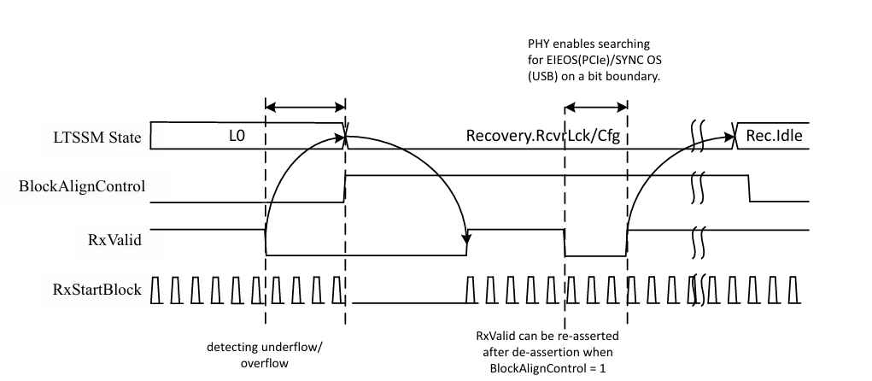
Block Alignment
Block Alignment can be done by using BlockAlignControlPin.
The PHY attempts to do alignment when BlockAlignControl is asserted and the PHY receiver is active.

Slide 48
Message Bus: Rx Margining Sequence
The MAC issues a write_uncommitted to address 0x1 followed by a write_committed to address 0x0 to set up the margining parameters and to start margining in the Rx Margin Control1 and Rx Margin Control0 registers.
The PHY issues a write_ack to acknowledge that it has flushed the write buffer. Subsequently, upon processing a change in the “Start Margin” bit of the Rx Margin Control0 register, the PHY issues a write_committed to address 0x0 to assert the “Margin Status” bit.
the MAC stops the margining process by issuing a write_committed to address 0x0 to deassert the “Start Margin” bit.

Slide 49
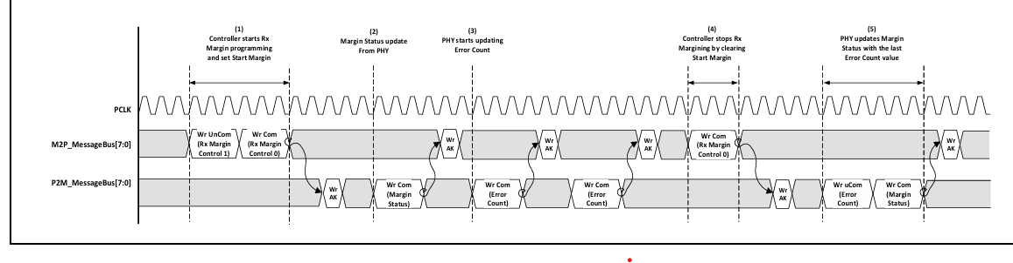

Slide 50
Message Bus: Equalization
Multiple RxEqEval requests are made during the equalization process corresponding to different coefficient requests to the far end transmitter.
When all the RxEqEval requests are complete, RxEqIn Process is de asserted.
The PHY does not necessarily have to write to both the Link Evaluation Feedback Figure Merit and Link Evaluation Feedback Direction Change register fields; it could write to only to one

Slide 51
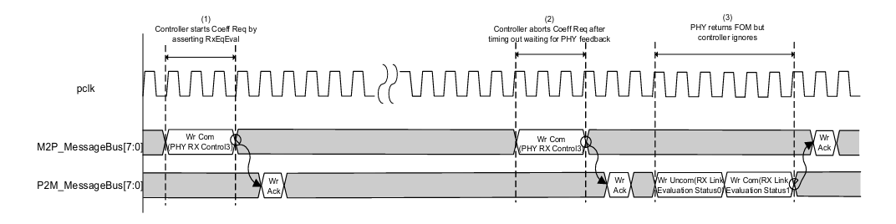

Slide 52
Loop Back
• For USB and PCIe modes, the PHY must support an internal loopback.
• In the SerDes architecture, loopback is handled in the MAC instead of the PHY.
The PHY begins to loopback data when the MAC asserts TxDetectRx/Loopback while doing normal data transmission (that is, when TxElecIdle is deasserted).

Slide 53
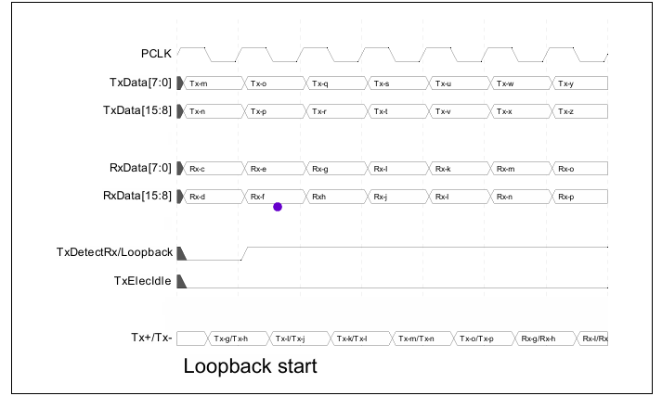
Loopback start
When the MAC asserts TxDetectRx/Loopback to the PHY, the PHY begins to loopback the received data to the differential Tx+/Tx- lines.

Slide 54
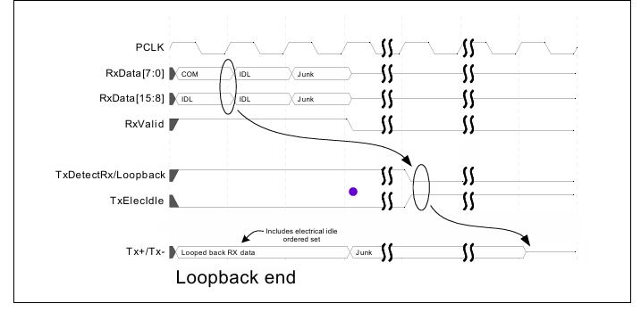
Loopback End

Slide 55
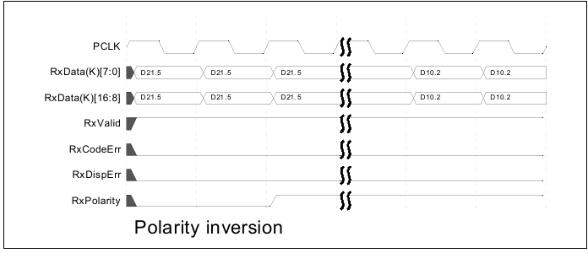
Polarity Inversion
To support lane polarity inversion, the PHY must invert received data when RxPolarity is asserted.
Inverted data must begin showing up on RxData[] within 20 PCLKs of when RxPolarity is asserted

Slide 56
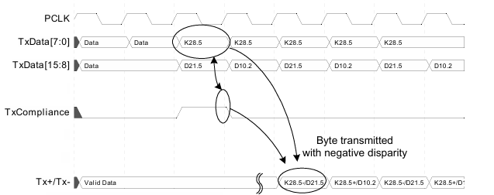
Setting Negative Disparity
To set the running disparity to negative, the MAC asserts TxCompliance for one clock cycle that matches with the data that is to be transmitted with negative disparity.
For a 16-bit interface, the low order byte will be the byte transmitted where running disparity is negative.
The example shows how TxCompliance is used to transmit the PCIe compliance pattern in PCIe mode. TxCompliance is only used in PCIe mode and is qualified by TxDataValid when TxDataValid is being used

Slide 57
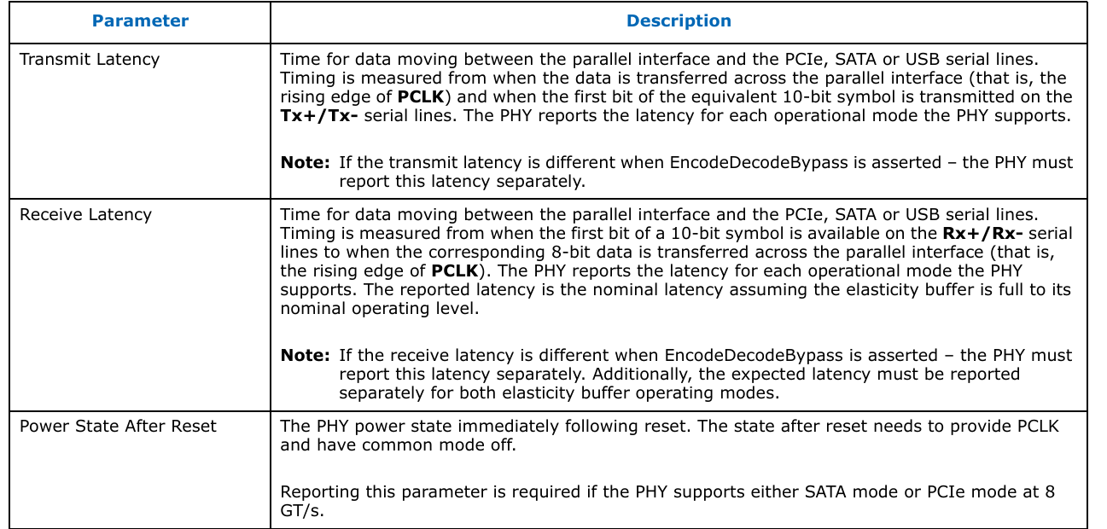
Parameters Advertised in PHY Datasheet

Slide 58
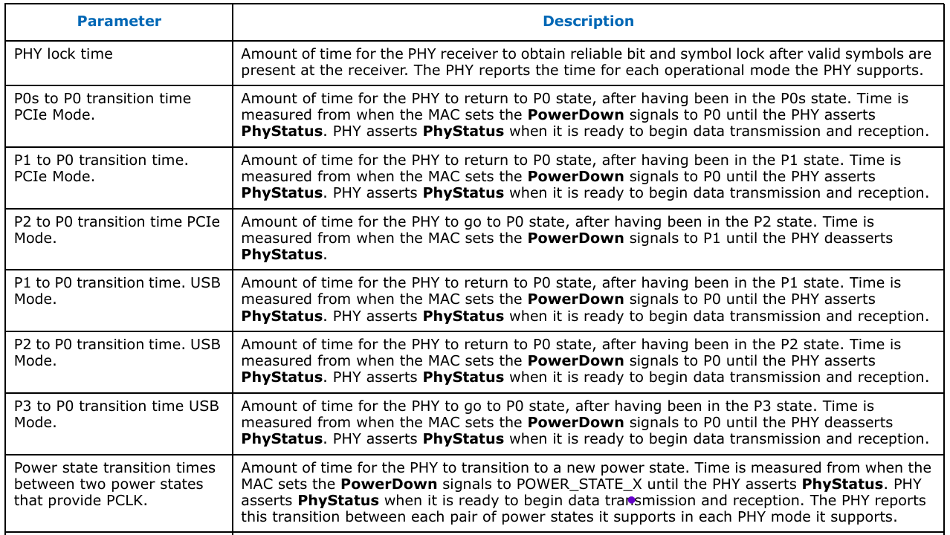

Slide 59
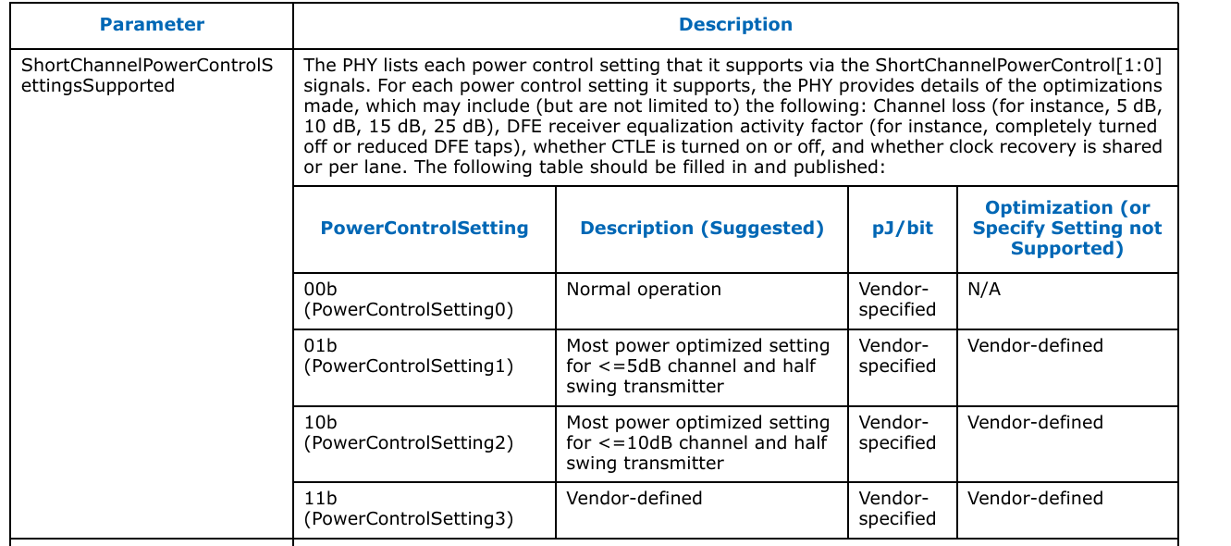

Slide 60
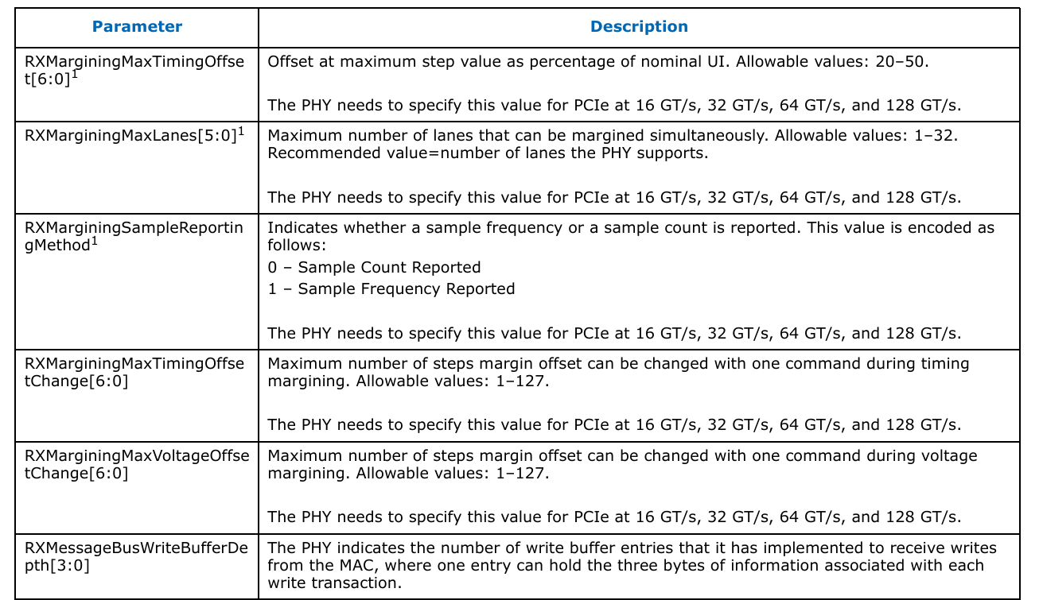

Slide 61
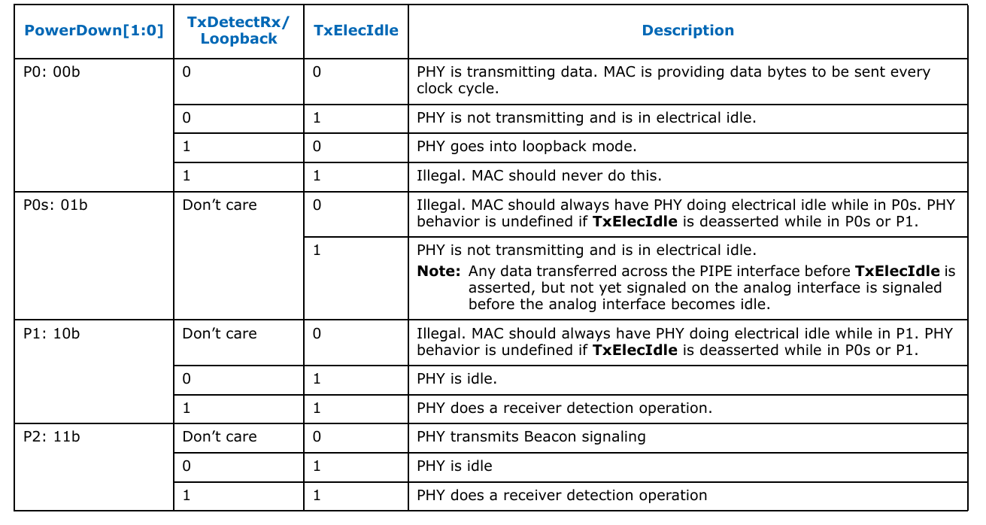
Control Signal Decode Table – PCIe Mode

Slide 62
128b/130b Encoding and Synchronization
128b/130b overhead: For every 128-bit block sent at 8/16/32 GT/s, the PHY must send 2 extra bits, creating a rate mismatch that needs periodic correction.
TxDataValid : The MAC must deassert TxDataValid for exactly 1 PCLK every N blocks to let the PHY flush the accumulated extra bits (N = 4 for 8-bit, 8 for 16-bit, 16 for 32-bit interfaces)
Reset / Electrical Idle rule: PHY internal buffers for this rate mismatch must be empty after reset and after exiting electrical idle, so the first TxDataValid deassertion happens immediately after the Nth block.
Rx side symmetry: The PHY uses RxDataValid the same way—it deasserts for one clock every N received blocks, starting right after the Nth block post-reset or idle exit.

Slide 63
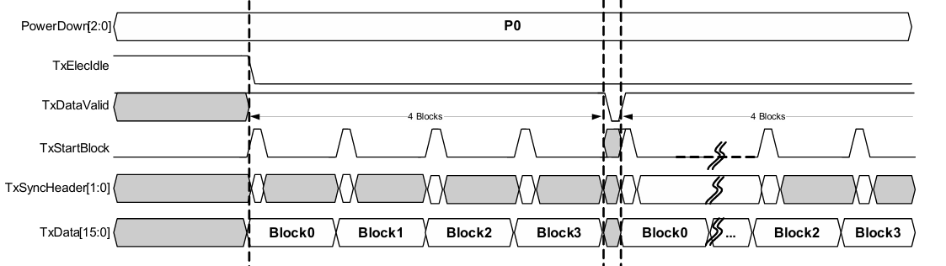
TxDataValid Timing for 8 Bit-Wide TxData Interface

Slide 64
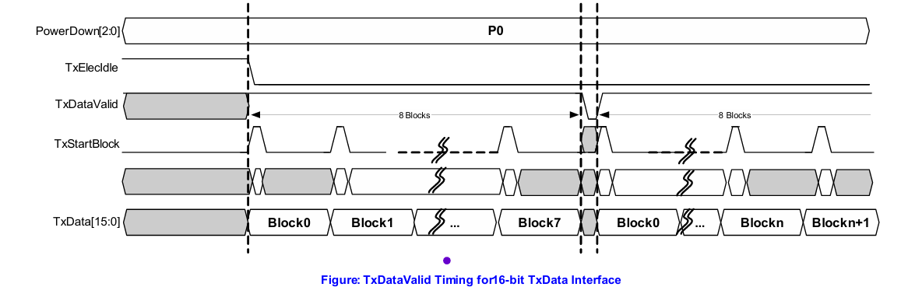
TxDataValid Timing for 16 Bit-Wide TxData Interface

Slide 65
Message Bus Interface
General Operational Rules
Reset & clock gating: Message bus can be used only after Reset# is deasserted, PCLK is stable, and PhyStatus is deasserted; it must go idle immediately when Reset# is asserted.
Write ordering rule: After a write_committed, the initiator must wait for write_ack before issuing any new writes; write_uncommitted sequences must end with write_committed (single write_ack).
Outstanding write limit: The initiator must not exceed the receiver’s write buffer capacity for total outstanding writes since the last write_ack.
Read restrictions: Only one read can be outstanding per direction, and the initiator must wait for read completion before issuing another read.

Slide 66
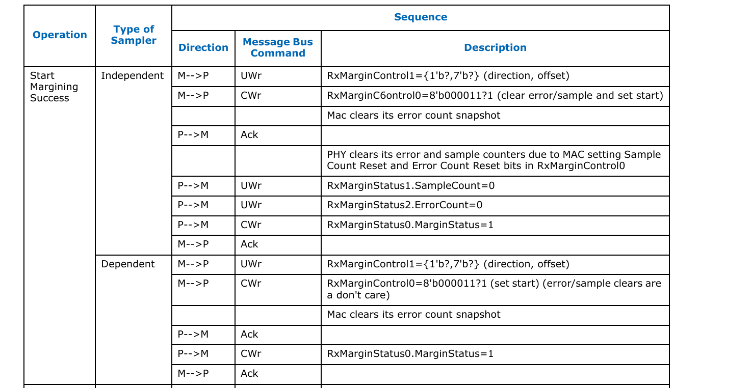
PCIe Lane Margining at the Receiver

Slide 67
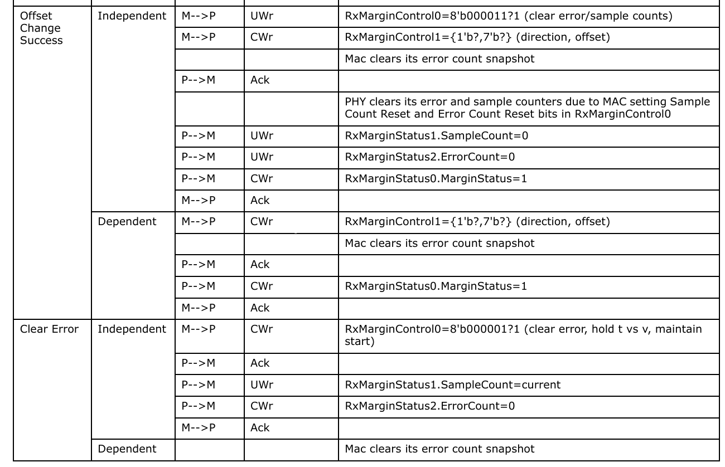
PCIe Lane Margining at the Receiver(Contd..)

Slide 68
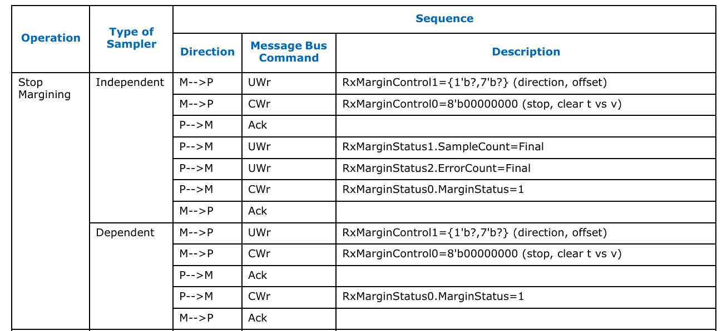
PCIe Lane Margining at the Receiver(Contd..)

Slide 69
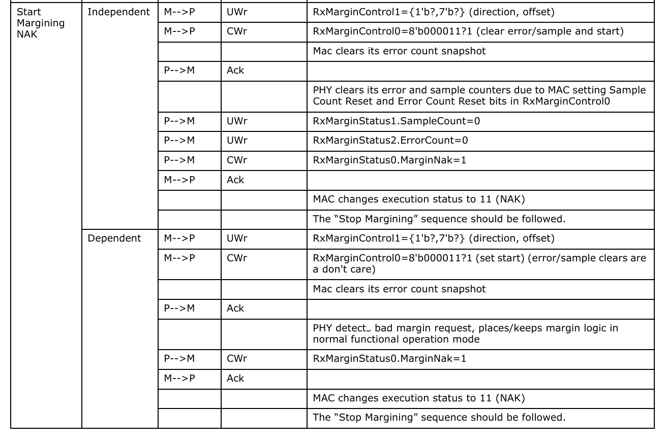
PCIe Lane Margining at the Receiver(Contd..)

Slide 70
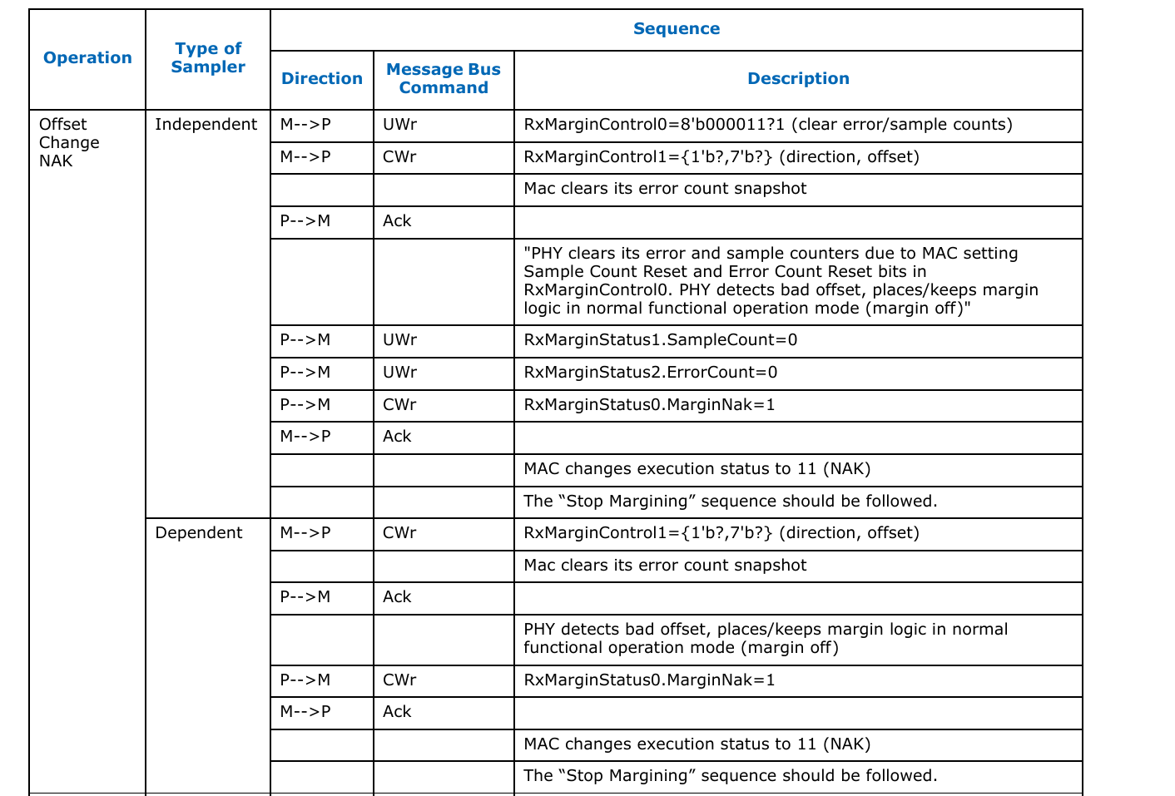
PCIe Lane Margining at the Receiver(Contd..)

Slide 71
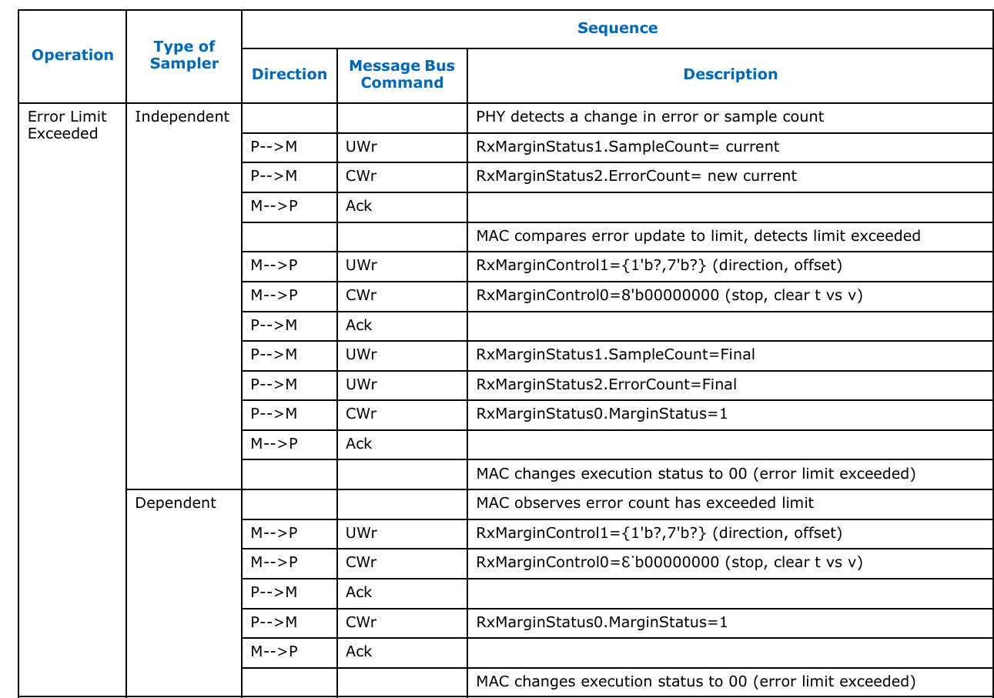
PCIe Lane Margining at the Receiver(Contd..)

Slide 72
Short Channel Power Control
For short-reach links (e.g., MCP applications), the design shall support reverting ShortChannelPowerControl[1:0] to normal mode if an optimized setting blocks link bring-up.
If an optimized mode is incompatible at 2.5 GT/s, normal mode shall be used to establish the initial link.
The control may then transition to an optimized power mode as the link switches to higher speeds.

Slide 73
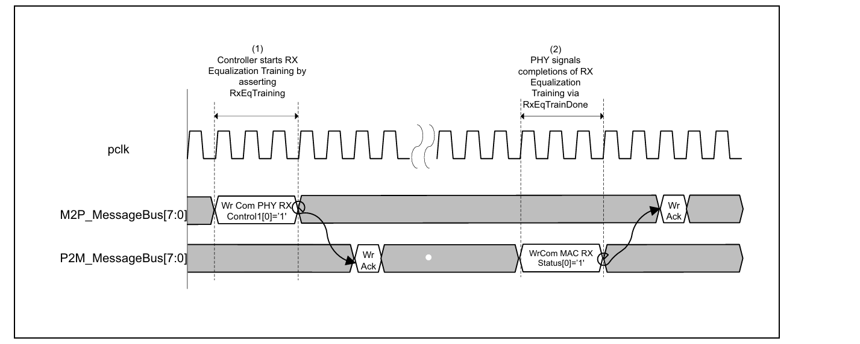
RxEqTraining
For PCIe, there are several scenarios where the controller may request that the PHY perform receiver equalization.
For PCIe, the PHY sets the RxEqTrainDone bit in the Rx Status0 register to indicate completion of receiver equalization.

Slide 74
PHY Recalibration
The PIPE specification provides mechanisms for either the controller or the PHY to initiate recalibration.
Recalibration must occur during Recovery, so if the PHY determines that a recalibration is necessary, it notifies the controller that it should enter Recovery and request a recalibration.
PHY notifying the controller that it should request a recalibration, then the controller follows the same steps as it would for a controller initiated PHY recalibration.
After the PHY notifies the controller that the recalibration operation is complete by setting the IORecalDone bit, the controller is permitted to exit Recovery and resume normal operation on the link

Slide 75
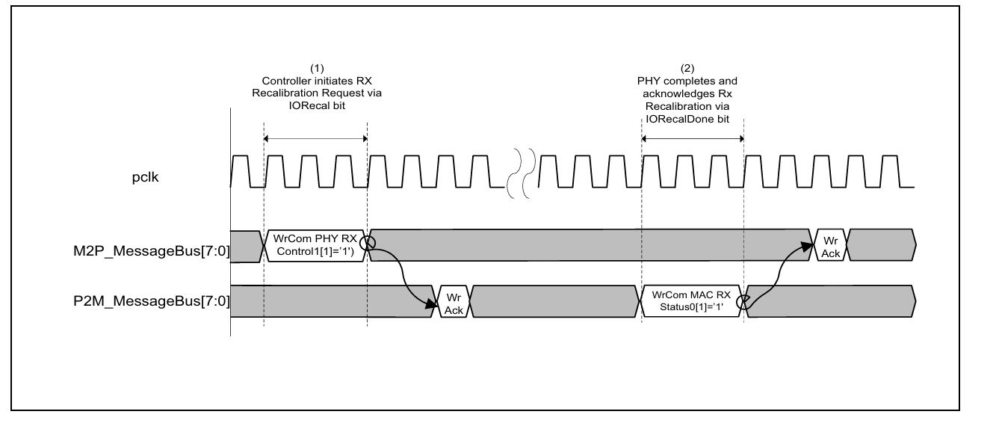
PHY Recalibration Initiated by Controller

Slide 76
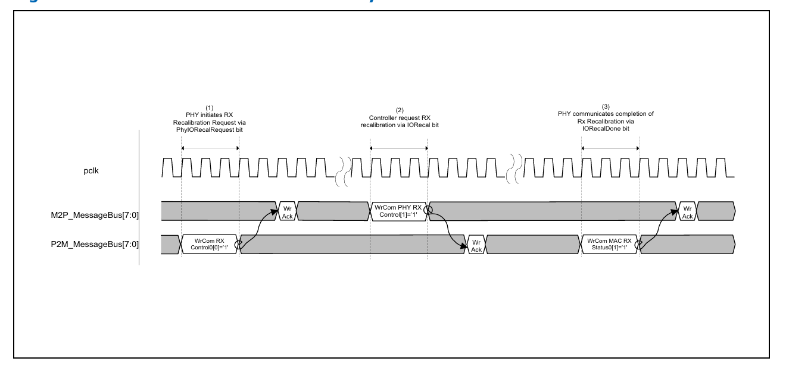
PHY Recalibration Initiated by PHY

Slide 77
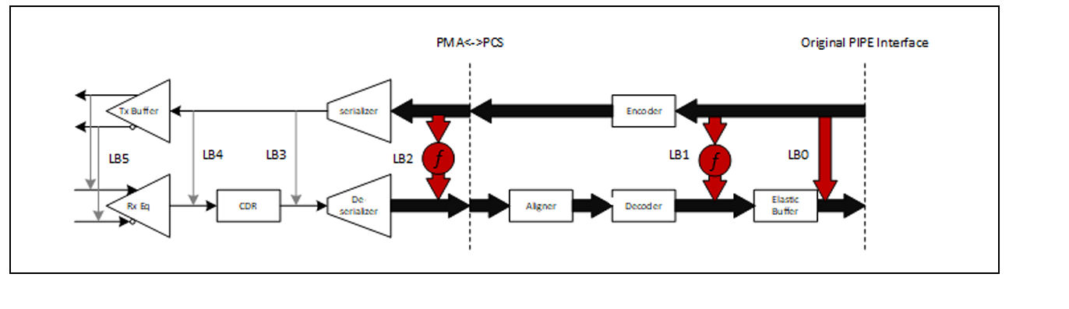
Digital Near End Loopback
The PIPE specification defines an optional Digital Near-End Loopback (DNELB) operational mode to facilitate HVM testing; toggling signals via functional testing in loopback mode enables fault testing.
PIPE Architecture: DNELB Path Examples

Slide 78
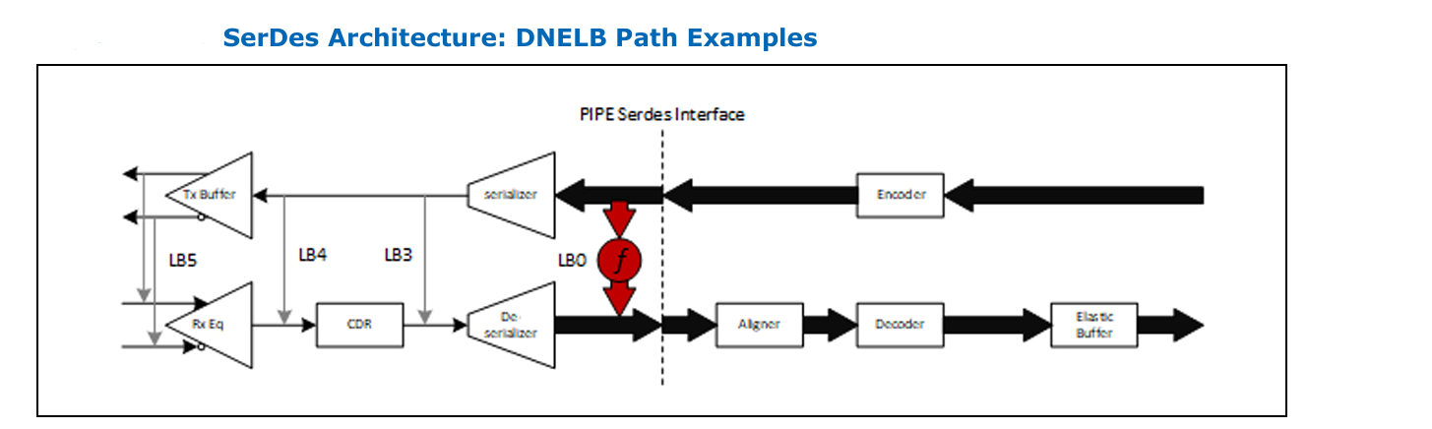
Digital Near End Loopback(Contd..)

Slide 79
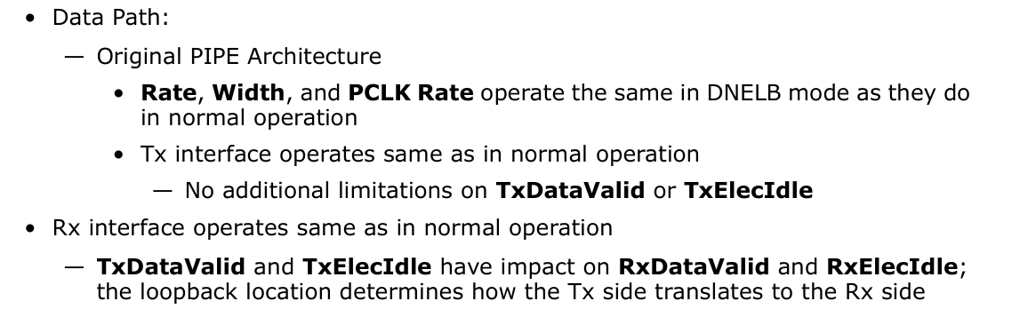
PIPE Operations and Signals in DNELB Mode

Slide 80
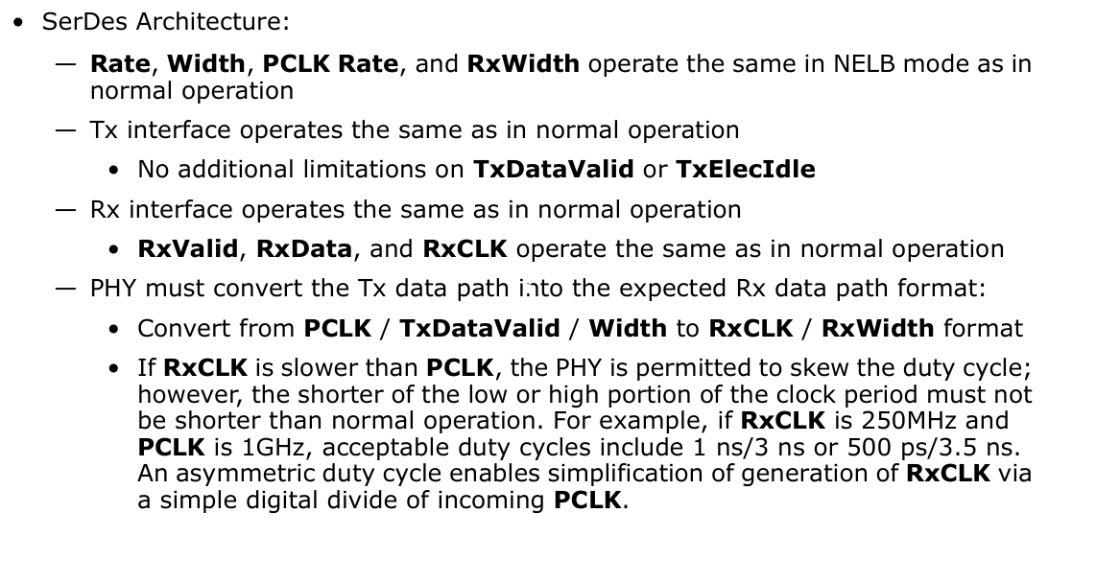
Digital Near End Loopback(Contd..)

Slide 81
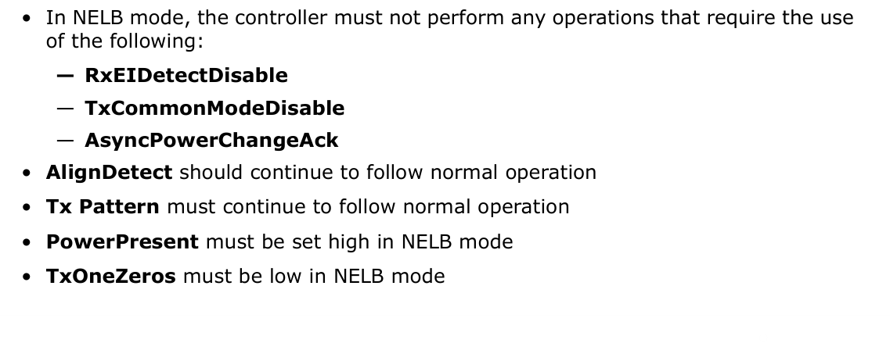
Digital Near End Loopback(Contd..)

Slide 82
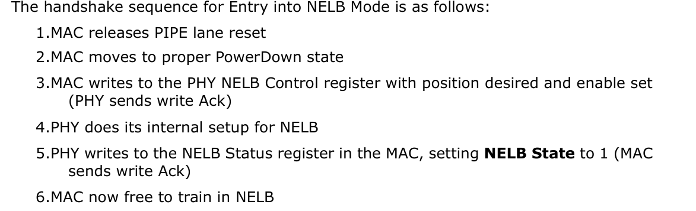
Entry and Exit from NELB Mode

Slide 83
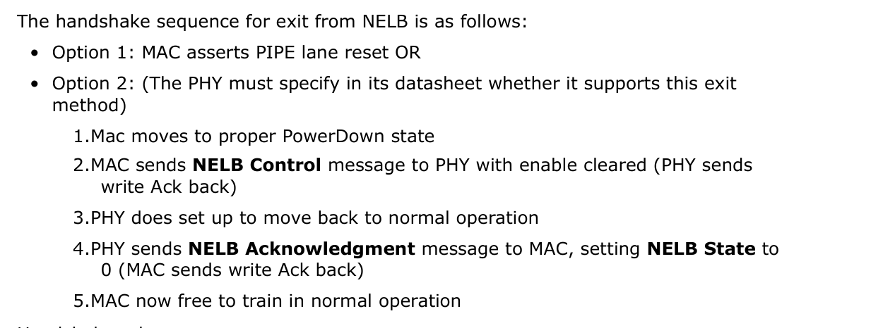
Entry and Exit from NELB Mode(Contd..)

Slide 84
Handshake rules
• Handshake must occur in a PowerDown state that has both Tx and Rx off but pclk running
• Handshake must complete prior to doing transmitter receiver detect if TxdetectRx is to be used
• Handshake may be done at any data rate if supported by PHY. The PHY must support the handshake at initial protocol defined rate (for instance, 2.5GT/s for PCIe)
• If PHY is to report an error in the NELB Status register on entry, the state must indicate out of NELB, and the PHY must remain functionally in normal mode
• The MAC is encouraged to use the exit error indication to initiate a PIPE lane reset or otherwise block functional operation.
• The LB Position cannot be changed while in NELB. NELB must be exited and re entered with the new LB Position.

Slide 85


